Slide 1

Microsoft Fabric
Jason Eisenzimmer – Technical Specialist
Notes:
To begin – we’ll share what we’ve been hearing from our customers and partners about their data and analytics challenges.

Slide 2

Agenda
Introduction to Microsoft Fabric and its challenges Features and capabilities of Microsoft Fabric Common scenarios addressed by Microsoft Fabric Pricing of Microsoft Fabric Getting started with Microsoft Fabric Empowering data professionals with Microsoft Fabric

Slide 3
What we’re hearing from our customers
Notes:
To begin – we’ll share what we’ve been hearing from our customers and partners about their data and analytics challenges.

Slide 4

Today’s data and analytics challenges
Limited scalability of legacy solutions as data demand rises exponentially
Growing BI adoption to drive a data-driven organization across LOBs and teams
Scaling data and analytics across the organization while reducing costs and optimizing existing data and management
Breaking down data siloes across the organization into a unified source of truth
Making data more accessible to technical and non-technical users in a governed and secure way
Delivering on the promise of analytics with limited resources
Notes:
How to balance the exponential demand for data access and BI tools a data-driven business requires with cost, data security, governance, and the potential of creating data silos??
We’ve talked to a wide range of customers who have led their organizations in data-first modernization. And we understand that businesses today face a variety of data and analytics challenges that can be difficult to navigate.
To put this into perspective, research shows “the amount of data created over the next three years will be more than the data created over the past 30 years.” Accessing and managing real-time data on the cloud is a top priority for long-term success. Investing in a comprehensive data & analytics platform can address the hurdles encountered in your current data ecosystem.
Source: IDC Global DataSphere Forecast, 2020

Slide 5
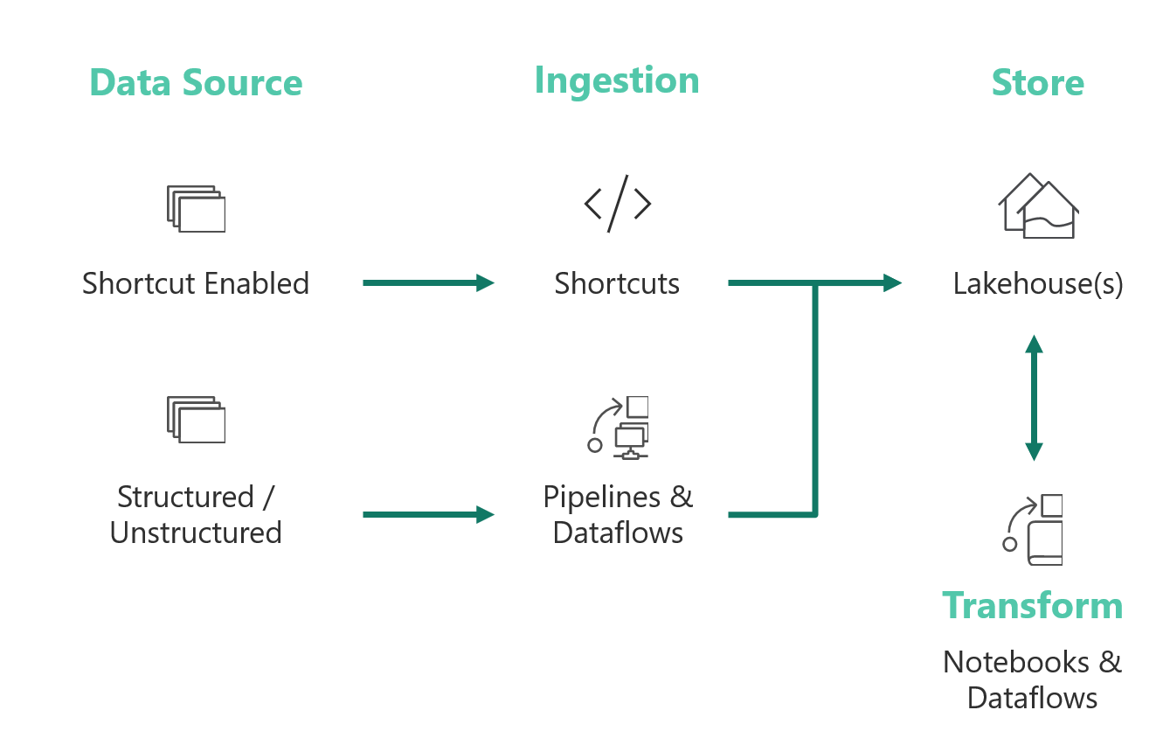
Why leverage Delta Lake?
Merger of Parquet with transaction logs
RDMS features on flat files
Schema enforcement
ACID transactions
Time Travel
ANSI SQL
Less duplication of effort
Decrease development speeds
Unlimited Scale
Auto scale is in Databricks’ DNA
Many levers to exactly fit your size
Acquire resources just when you need them
Release resources when you don’t
Spark is extremely powerful from a transformation perspective
Native ODBC/JDBC connectors available

Slide 6
Medallion Architecture – multiple data layers
 | Raw | Bronze | Silver | Gold
Who uses it? | Automated Processes | Data engineers | BI/Data Scientists | End consumers
What? | 1:1 copy of the data from the source system | Uncleaned raw data saved in delta format | Fix Bronze Schemas, remove errors, explode columns | Aggregated/ mashed up fact and dimension data
Why? | System of record | Exploration of raw data | Feature engineering | Analytics consumption

Slide 7
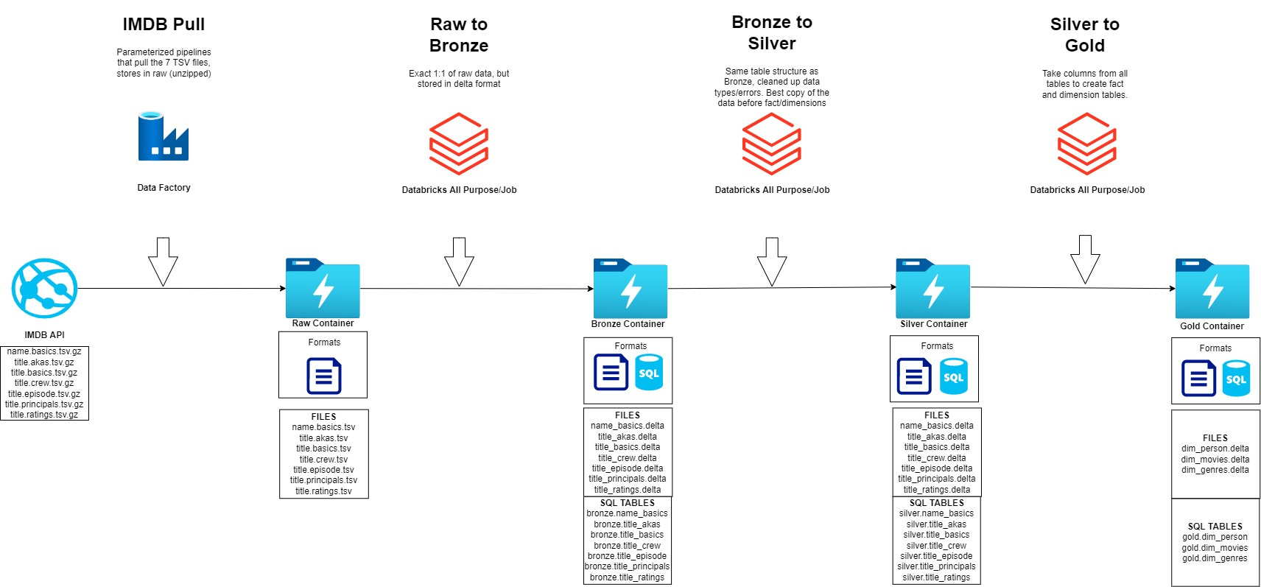
Data Flow :Step by Step
Transform
Serve

Slide 8

Features and capabilities of Microsoft Fabric
Notes:
So, how do you enable data-driven decisions, at scale, and integrate them into big picture strategy?
As we’ve seen, research shows that successful integration of both data and analytics improves time to insights and faster value realization. A comprehensive, unified ecosystem that leverages machine learning and artificial intelligence is key for all organizations to achieve success and data modernization.

Slide 9



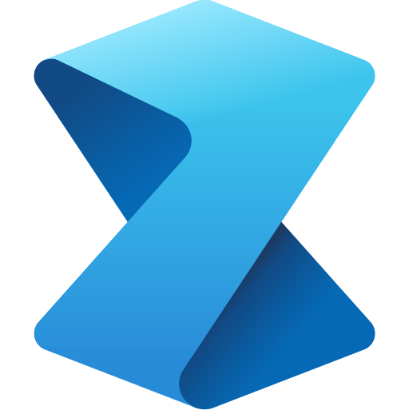

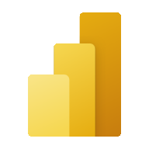


Microsoft Fabric does it all—in a unified solution
An end-to-end analytics platform that brings together all the data and analytics tools that organizations need to go from the data lake to the business user
Data Integration
Data Engineering
Data Warehouse
Data Science
Real Time Analytics
Business Intelligence
Observability
Data Factory
Synapse
Synapse
Synapse
Synapse
Power BI
Data Activator
Unified data foundation
OneLake
UNIFIED
SaaS product experience
Security and governance
Compute and storage
Business model
Notes:
Microsoft Fabric combines Data Factory, Synapse Analytics, Data Explorer, and Power BI into a single, unified experience, on the cloud. The open and governed data lakehouse foundation is a cost-effective and performance-optimized fabric for business intelligence, machine kerning, and AI workloads at any scale. It is the foundation for migrating and modernizing existing analytics solutions, whether this be data appliances or traditional data warehouses.
Talk Track for Greenfield/Growing Analytics Customers – Microsoft Fabric’s SaaS environment makes it easier to deploy an entire end-to-end analytics engine from the ground up at an accelerated pace. With the solution’s built-in security and governance capabilities, you can be rest assured your data and insights are protected.
Talk Track for Existing Synapse Customers – Microsoft Fabric is an evolution of Azure Synapse. You will still be able to enjoy the benefits and limitless scale of Synapse in an easier to use SaaS solution while adopting new capabilities that enhance your entire analytics approach. And with the addition of Power BI, you can help democratize the ability to uncover insights and create interactive reports across the organization, helping everyone make more data-driven decisions in their everyday work.
Talk Track for Existing Power BI Customers – With Microsoft Fabric, you’ll be able to access new and powerful data tools and services like Azure Synapse within the same user experience you already enjoy with Power BI. You can unify these tools with your disparate data sources in the same environment to establish a single source of truth for all data, driving the ability for everyone to uncover more accurate and consistent insights than before. And instead of having to worry about security concerns of a patchwork analytics estate, you can be rest assured your data is protected with the built-in security and governance capabilities.

Slide 10
Microsoft Fabric
“It just works"
Direct Lake Mode
5x5
SaaS
One Compute
OneLake
Frictionless onboarding
Predictable Cost
Minimal knobs
Any Data
New query mode
Instant provisioning
One Tenant Governance
Auto optimized
Anywhere
Fast Update
Quick results w/ Intuitive UX
Centralized Security
Auto integrated
No Movement
Top Performance
Notes:
5x5: Frictionless onboarding and instant provisioning.
SaaS: Predictable cost instead of variable consumption cost.
One Compute: Do more with less! Same compute resources are used for governance, warehousing, integration, data science, reporting, and analytics. No individual provisioning required, giving you optimized performance where it’s needed with the simplicity and savings of single compute.
One Data Lake: The world's first multi-cloud data lake (OneLake) for any data type, anywhere, without data movement.
Direct Lake Mode: Both the fast data updates of Direct Query combined with the performance of Import Mode all the time.

Slide 11







One Copy for all computes
Universal security makes it real
All the compute engines store their data automatically in OneLake
The data is stored in a single common format
Delta – Parquet, an open standards format, is the storage format for all tabular data in Analytics vNext
Once data is stored in the lake, it is directly accessible by all the engines without needing any import/export
All the compute engines have been fully optimized to work with Delta Parquet as their native format
Shared universal security model is enforced across all the engines
Data
Factory
Synapse Data
Engineering
Synapse Data
Science
Synapse Data Warehouse
Synapse Real Time Analytics
Data Activator
Power BI
Serverless
Compute
Spark
T-SQL
KQL
Analysis Services
OneLake
One Security
Customers 360
Finance
Service Telemetry
Business KPIs
Delta – Parquet Format
Delta – Parquet Format
Delta – Parquet Format
Delta – Parquet Format

Slide 12
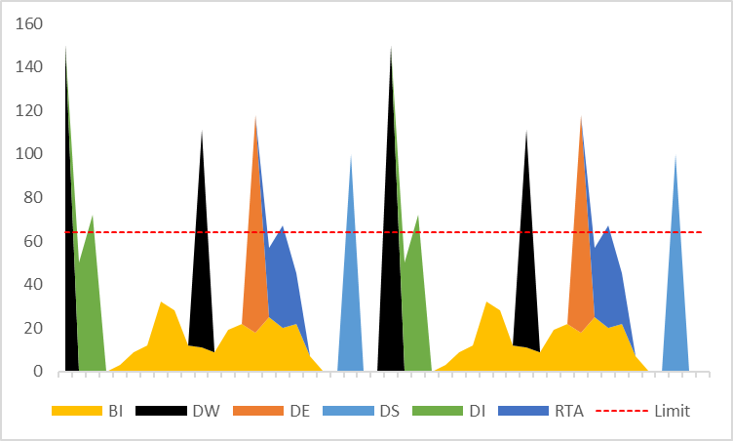
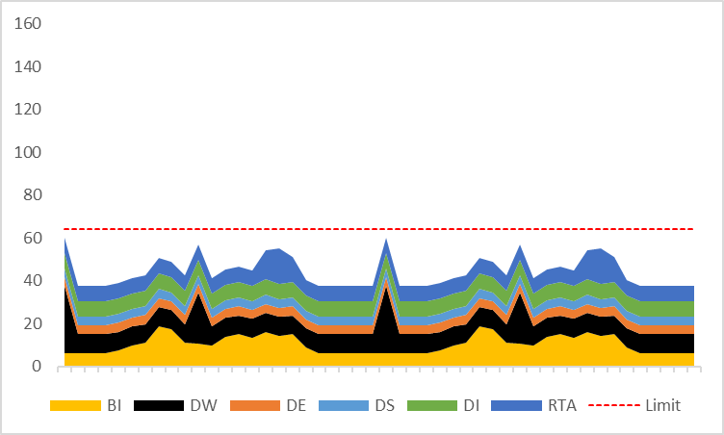
Smoothing before and after
Looking at an example of a 64 CU capacity, running multiple workloads over a couple of days…
Before Smoothing
Shows the actual load, on multiple workloads before smoothing
Bursting accelerates jobs execution by resource boosting
The capacity is overloaded 25% of the time
Some of the overloads are more than double the limit (bursting…)
There are periods of no/low usage
After Smoothing
Shows the reported load against the capacity limits
There is NO overload, and consumption is more stable
The smoothing of usage fills in gaps
Notes:
…so what does this actually look like?
In this example, we are looking at a capacity with 64 CAPACITY UNITS
Before smoothing we are looking at the actual load. - You see a lot of spikes pushing utilization well above the capacity limits based on bursting - (we'll talk about that next)… - but you can see that it is very overused at some slots and underused in others
After smoothing we are looking at the reported load against the capacity limits. - This is what counts against your purchased limit - The notable difference here is that there is no overload and a lot of the gaps in usage have been filled in.

Slide 13

Common analytics scenarios addressed by Microsoft Fabric
Notes:
Now that we have covered Microsoft Fabric’s capabilities, let’s take a deeper dive into the Microsoft Fabric’s architecture by showcasing some of the most common end-to-end analytics scenarios and how the suite can be applied to each.

Slide 14
Modern Data Warehouse
Modern Data Estate
Logs (unstructured)
Ingest
Stage
Prepare
Serve
Reporting
Media (unstructured)
Files (unstructured)
Azure Databricks
Azure Data Factory (ETL/ELT)*
Azure Data Lake Storage
Azure Synapse SQL Pool
(Relational Data Warehouse)
Power BI
Business/ custom apps (structured)
Azure Data Factory (ETL/ELT)

Slide 15
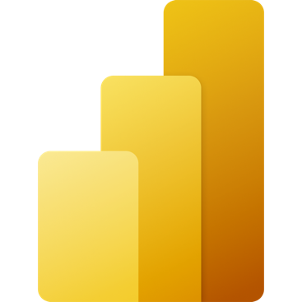
Lakehouse
Data Source
Ingestion
Store
Expose
Shortcut Enabled
Shortcuts
Lakehouse(s)
PBI
Structured / Unstructured
Pipelines & Dataflows
Lake Warehouse
Transform
Notebooks & Dataflows
Notes:
The Microsoft Fabric Lakehouse analytics scenario makes it so that data can be ingested into OneLake with shortcuts to other clouds repositories, pipelines, and dataflows in order to allow end-users to leverage other data.
Once that data has been pulled into Microsoft Fabric, users can leverage notebooks to transform that data in OneLake and then store them in Lakehouses with medallion structure.
From there, users can begin to analyze and visualize that data with Power BI using the see-through mode or SQL endpoints.

Slide 16
Data warehouse
Data Source
Ingestion
Store
Expose
Shortcut Enabled
Mounts
Data Warehouse
PBI
Structured / Unstructured
Pipelines & Dataflows
Warehouse
Transform
Procedures
Notes:
The Data Warehouse analytics scenario takes existing sources that are mounted, while pipelines and dataflows can bring in all other data that is needed.
IT teams can then define and store procedures to transform the data, which is stored as Parquet/Delta Lake files in OneLake.
From there, business users can analyze and visualize data with Power BI, again using the see-through mode or SQL endpoints.

Slide 17
Data science
Data Source
Clean & prepare
Store
Expose
Lakehouse & Data Warehouse
Notebooks
Lakehouse(s)
PBI
Train test & apply
Lake Warehouse
Models
Experiments
Notes:
The Data Science analytics scenario can be ingested similarly to the Lakehouse and Data Warehouse paths.
Once the data is ingested, it is cleaned and prepared using notebooks and then stored in the Lakehouse with medallion structure.
After the data is cleaned and stored, machine learning models can be trained and tested directly on the Lakehouse.
Like the other analytics scenarios, business users can analyze and visualize the data with Power BI using the see-through mode or SQL endpoints.

Slide 18
Real time analytics
Data Source
Ingestion
Store
Expose
Lakehouse & Data Warehouse
CI & Shortcuts
Kusto DB
PBI
Structured / Unstructured
Pipeline & Dataflows
Kusto Query
Event Streaming
Mirror
Notebook
Lakehouse & Data Warehouse
ML Model
Notes:
Unlike the Data Science, Lakehouse, and Data Warehouse analytics scenarios, streaming data can be ingested into the Microsoft Fabric in several ways to achieve real-time analytics.
Users can leverage Event Hub, IoT Hub, pipelines, dataflows, notebooks, or open-source products like Kafka, Logstash, and more.
Once ingested into the Microsoft Fabric, streaming data can be stored in Kusto DB and mirrored into Lakehouse. After the data has been stored, machine learning models can be trained and tested directly on the Lakehouse with experiments.
Like the other scenarios, business users can analyze and visualize the data with Power BI using the see-through mode or SQL endpoints. Data can also be exposed through KQL or notebooks using Spark.

Slide 19

Microsoft Fabric Pricing

Slide 20
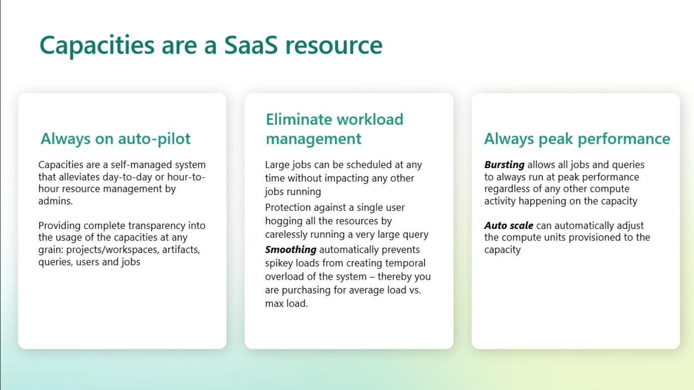

Slide 21
Translation for existing Power BI Premium per capacity Customers
COMPUTE
Power BI Premium P SKUs get access to the full Fabric capabilities
8 CUs are providing the same compute power of 1 Power BI Premium v-core for Power BI workloads. That is, F64 provides the equivalent compute power of Power BI Premium P1
Today
Microsoft Fabric Public Preview
SKU | PBI vCore
P1 | 8
P2 | 16
P3 | 32
P4 | 64
P5 | 128
SKU | CU
F 64 | 64
F 128 | 128
F 256 | 256
F 512 | 512
F 1024 | 1024
Notes:
Power BI Premium capacity customers pay the same monthly price, and now have access to the all the new analytics workloads as part of Fabric.
The compute unit that powers all these capabilities is changing from a Power BI vCore to Capacity Unit (CU). 1 PBI vcore is = to 8 CUs, so P1 SKU which has 8 vCores will convert to an F 64 vCore with 64 CUs, and all the PBI workloads consume the same capacity as they did before Fabric.
We are also maintaining the 100 TB of storage for Power BI artifacts. For all the new Fabric artifacts, customers will need to provision OneLake storage for those new workloads.

Slide 22
Fabric capacity pricing
COMPUTE
Fabric capacity is priced uniquely across regions. The following table shows the pricing at US West 2 for your reference. Fabric capacity can be purchased at Azure portal.
1 CU pay-as-you-go price | $0.18 / hour
SKU | Capacity unit (CU) | Pay-as-you-go (hourly) at US West 2 | Pay-as-you-go (monthly) at US West 2
F 2 | 2 | $0.36 | $262.8
F 4 | 4 | $0.72 | $525.6
F 8 | 8 | $1.44 | $1,051.2
F 16 | 16 | $2.88 | $2,102.4
F 32 | 32 | $5.76 | $4,204.8
F 64 | 64 | $11.52 | $8,409.6
F 128 | 128 | $23.04 | $16,819.2
F 256 | 256 | $46.08 | $33,638.4
F 512 | 612 | $92.16 | $67,276.8
F 1024 | 1024 | $184.32 | $134,553.6
F 2048 | 2048 | $368.64 | $269,107.2
Note:
1. Monthly rate calculation: F2 $0.18*2*730 =$262.8
2. Power BI Pro license requirement: (an existing requirement in Power BI Premium per capacity)
Consumption of Power BI reports requires Pro license for F2-F32
Publishing/authoring requires Pro license for all SKUs
Notes:
Fabric capacity will have pay-as-you-go option starting at Public Preview.

Slide 23


OneLake storage pricing at Public Preview
STORAGE
OneLake is a data lake built into Microsoft Fabric and provides a single place to store all organizational data. Data storage is charged at a rate of $ per GB per month.
Type | Pay-as-you-go price at West US 2
OneLake Storage | $0.023 per GB / month
Data Storage
Cross-region data transfer network charges may apply based on source/destination of each storage access. Learn more at the Bandwidth Pricing.
Data Transfer
Notes:
OneLake is a data lake built-into Microsoft Fabric and provides a single place to store all organizational data. Data storage is charged at rate of $ per GB per month.
As for data transfer across regions/clouds, it will be billed by the existing Azure Bandwidth pricing.

Slide 24
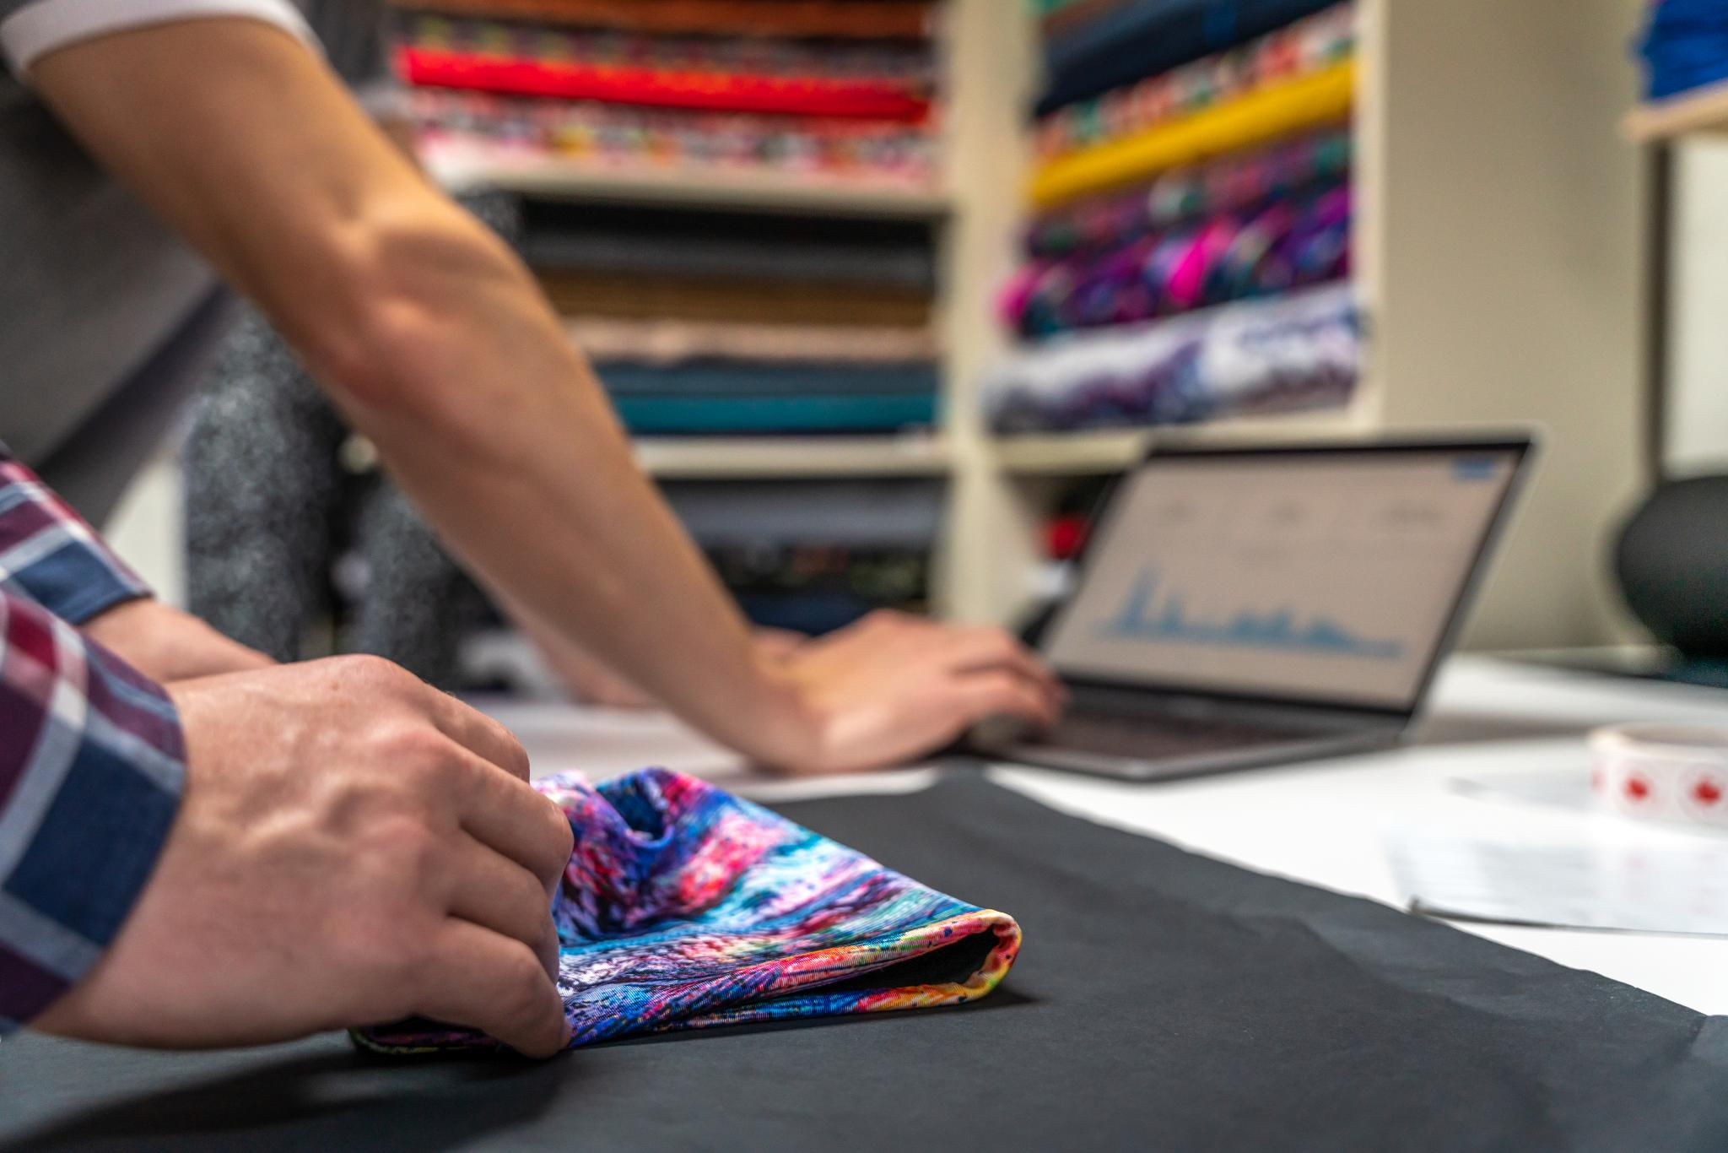
Getting started with Microsoft Fabric

Slide 25
Live Demo

Slide 26
Get started today
Explore the product here: https://aka.ms/try-fabric
Get your questions answered in the Microsoft Fabric webinar series: https://aka.ms/fabric-webinar-series
See the latest announcements in the Microsoft Fabric blog site: https://aka.ms/fabric-tech-blog
Read the implementation guide: https://aka.ms/Getting-Started-eBook

Slide 27
Thank you

